Slide 1
EBay e-commerce Website
Under Guidance of Mrs. Vaishali Sonanis Mam.

Slide 2
Introduction
To perform automation testing with the eBay website module wise ,detect the bugs and create a Test report by testing Test cases and prepare Test Analysis Report.
My eBay is one of the part of eBay platform where users can see a list of services for selling and buying items of there online store .
eBay is an online platform that allows users to create an e-commerce presence, enabling them to sell products ,buy products and services through the web to an online audience .

Slide 3
Overview
What is eBay?
eBay is a global e-commerce marketplace that allows users to buy and sell products through auctions or fixed-price listings. From electronics and fashion to collectibles and vehicles, eBay connects millions of buyers and sellers across 190+ markets worldwide.
My eBay is your personal dashboard within the eBay platform. It helps users manage their buying and selling activities, track orders, view saved items, and monitor bids. It’s a centralized space that gives users full control over their eBay experience.
It helps users to create an online store to sell and as well as to buy various product across the world.
Create your own eBay store, customize your branding, and start selling to millions of active buyers. With tools like My eBay, seller analytics, and promotional features, eBay empowers you to grow your business with ease.

Slide 4
Modules
Module 1 : Sign in page
Checked all the functionalities on Sign in page which included personal info as email
, password, Create account, forgot password, authentication with mobile number with OTP.
Module 2 : Search page
Checked all the functionalities on search page which included item details,
Quantity, Search button, compare button, product info , list button.
Module 3 : Addtocart page
Checked all the functionalities on Addtocart page which included item details by
clicking the product description, Quantity, Add to cart button, product info, remove from cart .
Module 4 : Rightclickon product image page
checked by clicking product image right click it is showing the correct product description
are functioning properly or not.

Slide 5
Module 5 : Shopbyall category page
Checked show all available products on screen under shopbyall category. By clicking different categories whether is it showing the respective items properly or not. .
Module 6 : Account settings page
Checked that change username and change address ,and account related information buttons and links are clickable are not and working properly are not in this account settings page.
Module 7 : Footer page
Show all valid details on header and footer like ,, contact us,, all info about site(terms and conditions, about us, contact us),country change, Language change.

Slide 6
Defects
While running a test case at certain point some fields are not working as it is expected which is nothing but a defect, so I have created a Defect report on those defects.

Slide 7
Defect identifier :- B_001
Defect summary :- In signin page for create an account it is accepting first name with a single alphabet and remaining are numbers same for the last name and email has to be verified to create account.
Ø Test Id :- TC_020
Ø Test case name :- TC_Signin_page _create_account_first_name
Ø Module name :- Signin page
Ø Reproducible :-
Ø Severity :- medium
Ø Priority :- medium
Ø Raised by :- Jagadheeswarreddy(Tester)
Ø Assigned to :- developer Team lead
Ø Date of assignment :-
Ø Status :- pending
Ø Snap shots :-
Ø Fixed by :- developer
Ø Date of fixing :-

Slide 8
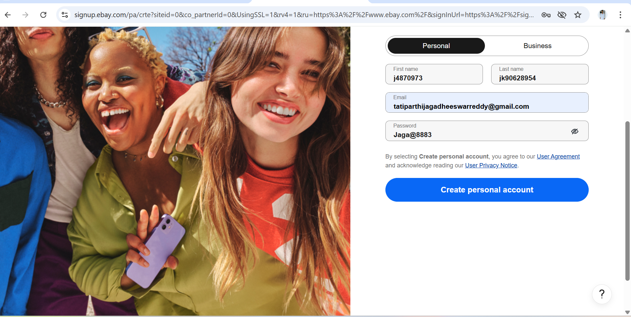

Slide 9
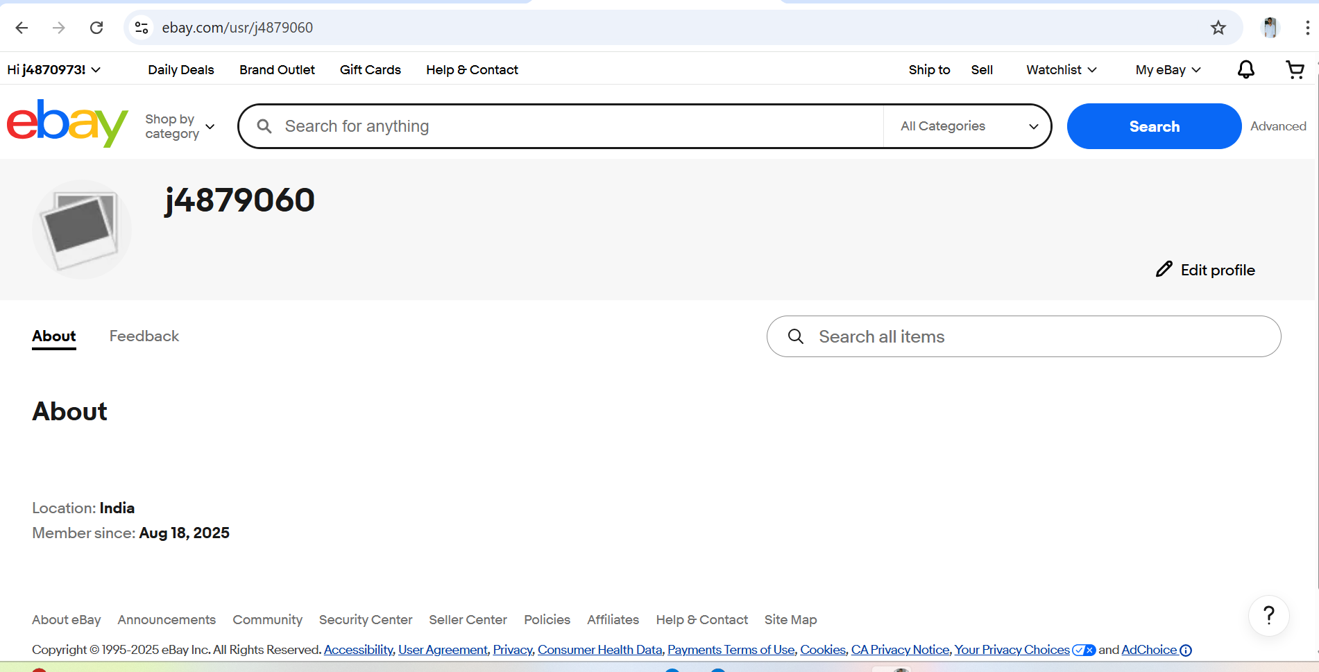

Slide 10
Challenges
While testing eBay website which contains huge data i faced some challenges about:
There is comes difference in writing a test case and while running it.
Faced some exceptions while testing test cases if one test case fails .
Handled those issues by adding dependencies and conducted parallel testing, integration testing without affecting the other test cases.

Slide 11
Experience
Gained hands on experience in automation testing with the tools like selenium , web drivers, TestNG framework.
Help to find out bugs.
Manual testing needs strong observation and in that testers needs to apply all possibilities in test cases.
Testing modules separately helps in find outing bugs easily.
By giving the severity and priority it is easy to developers to find the bugs and fix them according to their severity and priority.
Testing modules using the priority by default priority is given as 0.

Slide 12
Thank You!!!
Vaishali Mam For Guiding Us through out the Project.

